Slide 1
Project 4 Progress
Team Butterfly: Adam Lechliter, Ben Mathys, Jing Wen, Lucas Wu, Songyuan Wu

Slide 2
Outline
Team Organization
Architectural Design
Problems and Solutions
Areas of Improvement
Tools/Gems Used
Demo

Slide 3
Team Organization and Work Distribution
Main focus: Allow team members to pick the feature they want to work on
Application Submission: Jing Wen
Administrator Interface: Songyuan Wu
Available Courses/Sections: Adam Lechliter
Recommendation Submission: Lucas Wu
Grader Evaluations: Ben Mathys
Project Manager: Ben Mathys
External data scraping was completed in the previous project, so only minor tweaks were needed

Slide 4
Architectural Design
Web Scraper:
Store class data in JSON files before adding to database
Pros:
Easy format to read from (Ruby Standard Library)
Cons:
Adds some bloat to the server
Each course requires a file, sometimes multiple are required due to API result
Results for all semesters are not stored
Each semester must be scraped and loaded sequentially

Slide 5
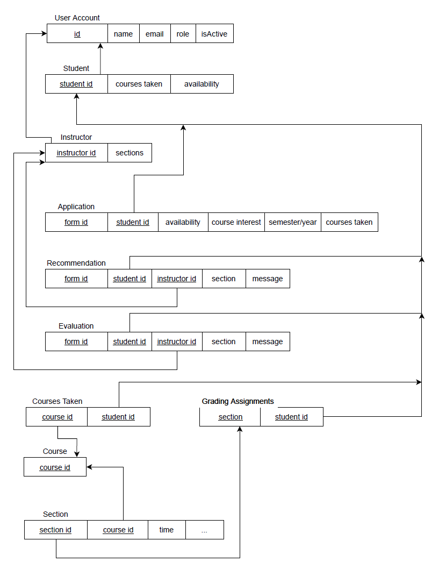
Architectural Design
Database:
Needed to modify the database to support the needs for this project
Create models for user roles, and forms
Pros:
Easier to link data to users with more models
Cons:
Database structure is increasingly complex as more models are added
Early Database Schema - Adam Lechliter

Slide 6
Problems and Solutions
Handle multiple semesters with the scraper
Only scraped and stored SP22 semester
Need to scrape and keep track of different semesters courses
Ideas:
Add a semester model to keep track of every semester that can be scraped

Slide 7
Problems and Solutions
Optimize the scraper to run faster than before
Scraped each course section data by entering the each section’s further page
Took much more time, although can get more detailed data
Ideas:
Use the API call, which returns the JSON files of the results
Also can get a lot of information about each course section
Less than a minute, much faster than before

Slide 8
Problems and Solutions
Optimize the administrator interface
The admin cannot set # of graders required for a particular section
The admin cannot get the information about the remaining grading position still needed for each section
Ideas:
Create a simple helper function that calculates the number of remaining grading positions

Slide 9
Problems and Solutions
Optimize the availability part of application submission
Just let the applicant enters available times as string
Need be the uniform format of each applicant input
For applicants, easier to fill in
For the admin, easier to view
Ideas (in process):
Generate a matrix of selectable checkboxes for time choosing

Slide 10
Areas of Improvement
Use css styles to modify the layout of the page
Write an interface in home page to display all the information about the user（s.t. Recommendation, application, and courses taken)
If a certain number of credits are exceeded, the user cannot add more classes
Each section can only have one instructor(new instructor for that section will replace the old one)
Set up a way to recommend a group of students

Slide 11
Tools/Gems Used
Bootstrap-sass Gem
We used it for css styling
Mechanize Gem
We used it in scraper for automating interaction with websites

Slide 12
Demo

